Slide 1
Final Project
Neural Network Inference on FPGA
ECE 6213
Osama Yousuf, Joseph Riem

Slide 2
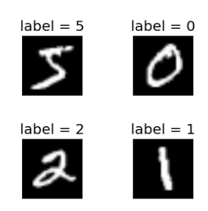
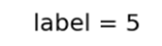
Background
What is a neural network?
What does inference mean? What does training mean?
Let’s understand with a simple example for image classification.
Input
MNIST Handwritten digit dataset (0-9)
Black box
Universal Function Approximation
Output
Prediction of the digit
NEURAL NETWORK
The black box (neural network block) takes an image as input and predicts the digit in that image as output.
Notes:
For the course project, we would like to entirely focus on Phase 1, but if we’re able to get a hold of the boards and the project with sufficient time we’ll proceed with working on the other phases.

Slide 3
Neural Network Operation
The neural network has two modes of operation
Training
Same images are presented repeatedly
The network makes predictions
Internal parameters are updated based on how good (or bad) the prediction is
Repeat until predictions are satisfactory!
Inference
New images are presented, not seen before in training
The network makes predictions
No updates to internal parameters
for this class project:
Software
FPGA
Notes:
For the course project, we would like to entirely focus on Phase 1, but if we’re able to get a hold of the boards and the project with sufficient time we’ll proceed with working on the other phases.

Slide 4
Specification
Linear Neural Network
Dataset: MNIST
Contains 60,000 training images, 10,000 testing images
Each image is of handwritten digits labelled 0-9, and is 28 x 28 pixels originally
For FPGA implementation, we have reduced the problem size to 18 x 18, and have binarized images (image pixels are either 0 or 1).
Network architecture:
2-layer perceptron network
324 x 10 x 10 (initial tests show that this is a good fit for our for FPGA)
Activations: ReLU (easier to implement on FPGA compared to Sigmoids)
Loss: CrossEntropy (okay to use anything - happening in software)

Slide 5
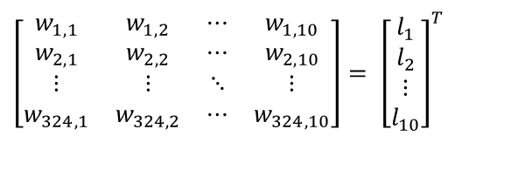












How does Inference happen?
Input
NEURAL NETWORK
What happens inside the neural network?
Matrix Multiplications (primarily)!
Output
Input
Input Vector
Linear Layer 1 (324, 10)
$${\left[\begin{matrix}p_{1} \\ p_{2} \\ ⋮ \\ p_{324}\end{matrix}\right]}^{T}$$
${\left[\begin{matrix}p_{1} \\ p_{2} \\ ⋮ \\ p_{324}\end{matrix}\right]}^{T}$*
$$\left[\begin{matrix}w_{1, 1} & w_{1,2} & ⋯ & w_{1, 10} \\ w_{2,1} & w_{2,2} & ⋯ & w_{2, 10} \\ ⋮ & ⋮ & ⋱ & ⋮ \\ w_{324, 1} & w_{324, 2} & ⋯ & w_{324, 10}\end{matrix}\right]= {\left[\begin{matrix}l_{1} \\ l_{2} \\ ⋮ \\ l_{10}\end{matrix}\right]}^{T}$$
$$18 x 18 to 1 x 324$$
Vectorize
$$1 x 324$$
Passed to Layer 1
$$1 x 10$$
Passed to ReLU
Linear Layer 2 (10, 10)
Output
$${\left[\begin{matrix}{ReLU(l}_{1}) \\ {ReLU(l}_{2}) \\ ⋮ \\ {ReLU(l}_{10})\end{matrix}\right]}^{T}= {\left[\begin{matrix}i_{1} \\ i_{2} \\ ⋮ \\ i_{10}\end{matrix}\right]}^{T}$$
${\left[\begin{matrix}i_{1} \\ i_{2} \\ ⋮ \\ i_{10}\end{matrix}\right]}^{T}$*
$$\left[\begin{matrix}x_{1, 1} & x_{1,2} & ⋯ & x_{1, 10} \\ x_{2,1} & x_{2,2} & ⋯ & x_{2, 10} \\ ⋮ & ⋮ & ⋱ & ⋮ \\ x_{10, 1} & x_{10, 2} & ⋯ & x_{10, 10}\end{matrix}\right]= {\left[\begin{matrix}o_{1} \\ o_{2} \\ ⋮ \\ o_{10}\end{matrix}\right]}^{T}=O$$
$$argmax (O)$$
$$1 x 10$$
Passed to Layer 2
$$1 x 10$$
Passed to Softmax
ReLU is a non-linear activation function, defined as $ReLU\left(c\right)=max⁡(0, c)$
Note: Weight matrices are the “internal parameters” referred to earlier
Notes:
For the course project, we would like to entirely focus on Phase 1, but if we’re able to get a hold of the boards and the project with sufficient time we’ll proceed with working on the other phases.

Slide 6
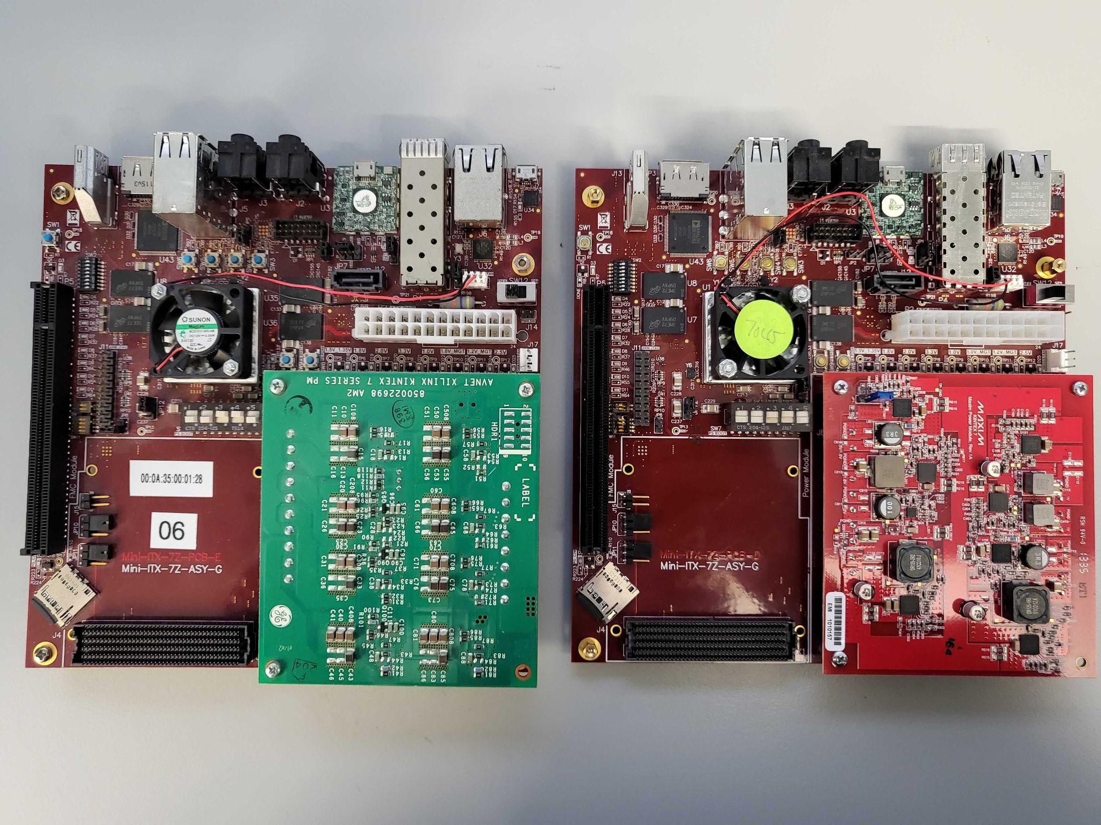
Project Overview
Phase 0: Implement neural network training in software
Phase 1: RTL simulation for neural network inference
Phase 2: Synthesize + Deploy RTL on Mini-ITX Zync 045/100 FPGA
High Level Synthesis mostly done, Custom RTL pending
Phase 3: Study how reducing network bit-precision impacts network accuracy in simulations (%)
Phase 4: Implement inference based on live-camera feed instead of preset testing dataset
Mini-ITX Boards in ADAM Lab @ GW
Hard processor (PS) + FPGA Fabric (PL)

Slide 7
Project Stages
High-level Synthesis (HLS)
Directly generate RTL code for inference based on Python code using HLS libraries (hls4ml, Vivado HLS)
Almost wrapped up!
Simulation + Synthesis + Implementation done
PS sends images to the neural network on PL via a DMA interface.
Custom RTL
Write our own RTL code for inference
Simulation results verified!
Synthesis + Implementation done
Need to figure out RTL packaging so that PS-PL communication can be utilized
Web Camera Integration
Faced a hiccup, PS doesn’t recognize USB devices
Worked around by having a camera run over network
The PS can capture an image over ethernet!
Needs finishing touches once we have ironed out the custom RTL branch.
Stage 0
Development Setup
Stage 1
High-Level Synthesis
Custom RTL
Stage 2
Web Camera Integration
Stage 3
Class Presentation + Report

Slide 8
Workflow for the High-Level Synthesis (HLS) branch
Step 1: Network training in PyTorch
Step 2: Conversion from Python to C
Step 3: Conversion from C to RTL
Step 4: Block Diagram for the Mini-ITX board
Step 5: PYNQ Overlay + Python Driver
Step 6: Final Inference

Slide 9
HLS Details – Initial Setup
Step 1: PyTorch Network
MNIST, 324 x 10 x 10, ReLU activations, CrossEntropy for training
Step 2: Conversion from Python to C (hls4ml)
Layer-wise quantization has to be provided
Example: Layer 1 – fixed point – 16 bits total, 8 bits fractional
PyTorch environment setup was difficult, but figured out solutions
Step 3: Conversion from C to RTL (Vivado HLS 2019.1)
hls4ml C code is written for Vivado HLS
In 2022.1, there is no Vivado HLS, Xilinx changed to Vitis HLS, so I had to use a compatible version
Used Vivado 2019.1
The output is an IP block that supports an AXI interface for communication
Note: Did some manual hacking to add support for the Mini-ITX board with their “VivadoAccelerator” backend

Slide 10
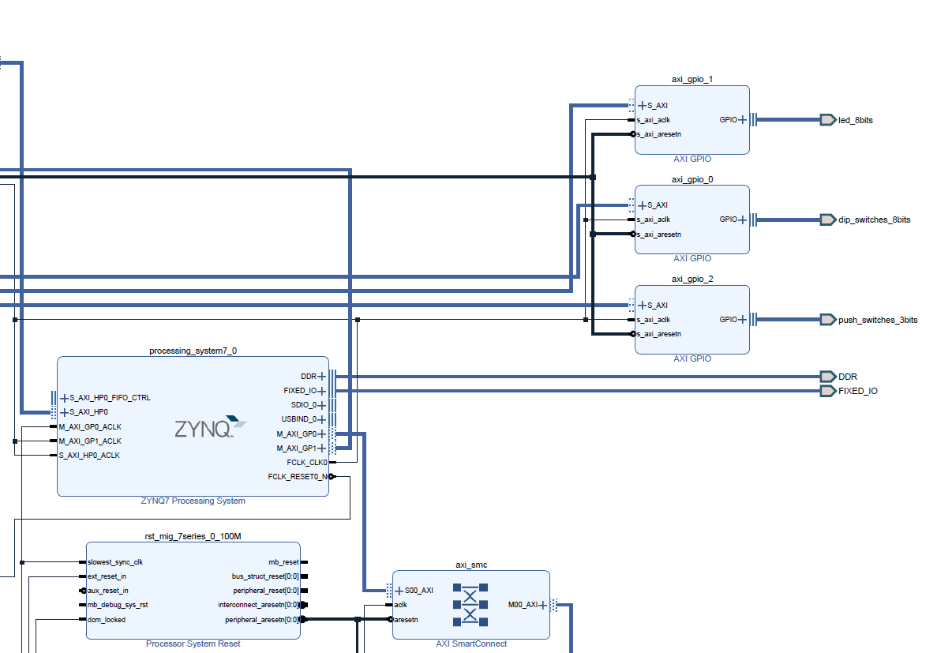
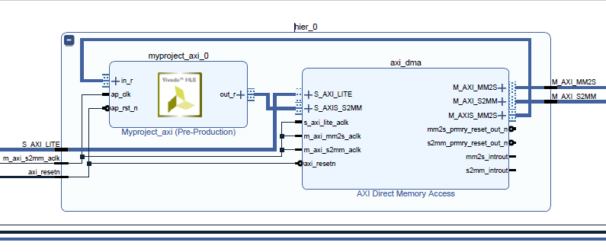
HLS Details – IP Integration in Vivado
Step 4: Block Diagram for the Mini-ITX board with the HLS IP
DMA interface between the PS and the Neural Network IP, design synthesizes without errors.
We load a testing image on the PS, place it inside a DMA buffer, which is then read by the NN IP block on the PL
The bitstream can be loaded dynamically on the hard processor
Our HLS Neural Network IP Block, runs on the PL
The ZYNQ PS

Slide 11
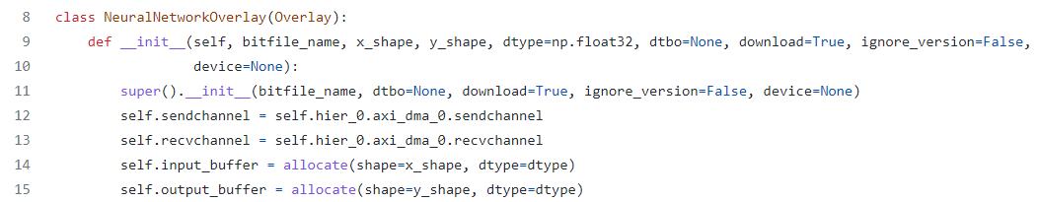
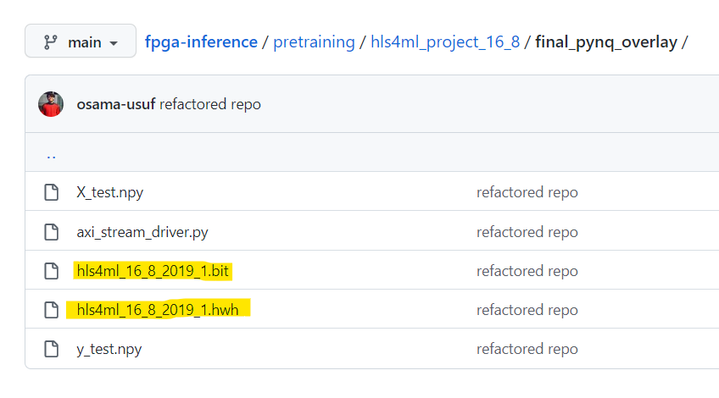
HLS Details – Requirements for PS-PL communication
Step 5: PYNQ Overlay + Python Driver
An overlay is just a bitstream + hardware handoff files (generated by Vivado after synthesis)
The driver is just a clean interface that wraps around DMA communication
Instead of send_channel.send() and receive_channel.receive() on the bitstream, we can directly to network.predict(input)

Slide 12
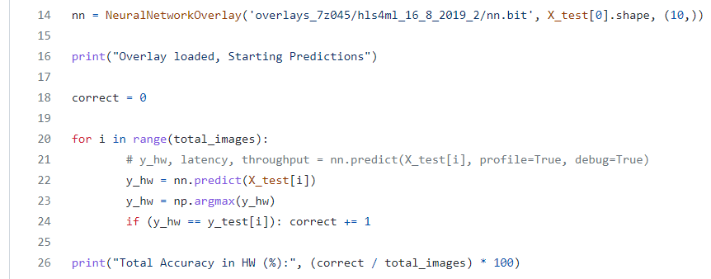
HLS Details – On-board Inference
Step 6: Final Inference

Slide 13
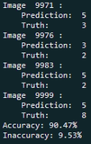
Workflow for the Custom RTL branch
RTL flow
Top module
MM1(matA1, matB, mm_act) This module performs matrix multiplication for layer 1
fullReLU(mm_act, act_out) This module is an activation function for inference
MM2(matA2, act_out, mm2_out) This module performs matrix multiplication for layer 2
label(mm2_out, label_out) This module gives the prediction for the number
Testbench outputs a labels_v.txt file that has all the predictions for the number
We use fixed-point representation for the network weights and input images
Short verification script
Compared the output of the labels_v.txt file to the actual values
90.47 % accuracy on this neural network using:
16-bit fixed-point precision 1 signed bit, 4 integer bits, 11 fractional bits S|III I|FFF FFFF FFFF
Python verification script computes accuracy over the testing dataset

Slide 14
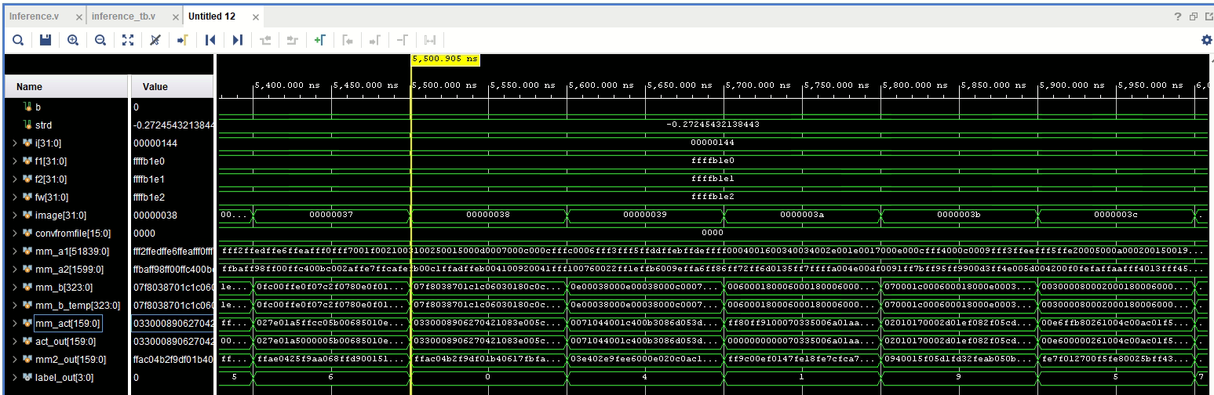
Custom RTL – Simulation Waveforms
The testbench loads a test image every #100 time units and we can see that a prediction is made on label_out, which is a number [0, 9]
Recall that there’s a total of 10,000 testing images!
Layer 1 Weights
Layer 2 Weights
Input Image
Layer 1 Output
ReLU Output
Layer 2 Output
Output Prediction

Slide 15
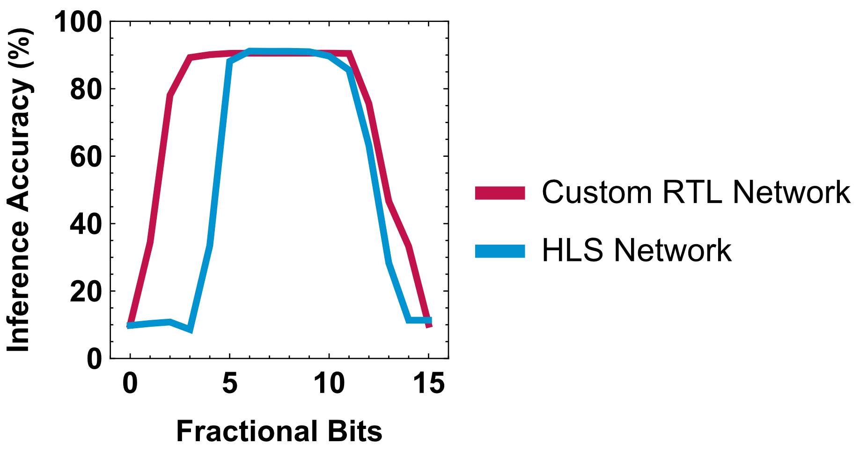
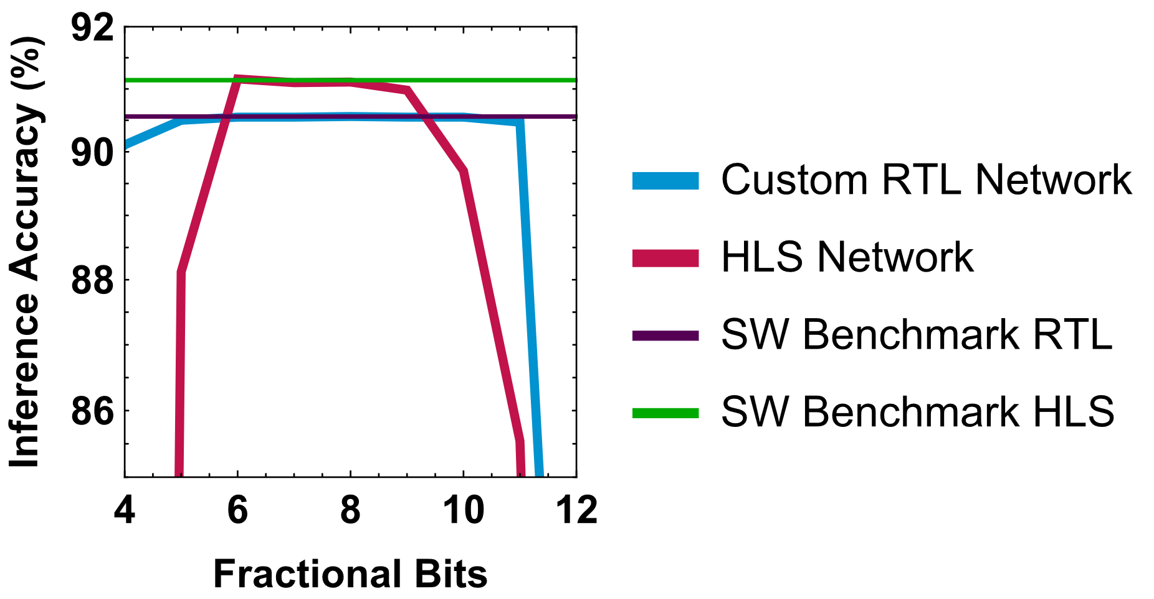
Exploring Weight Quantization
Observations:
HLS network can achieve higher accuracy, but has a tighter quantization window compared to the custom RTL
Differences:
Weights are different, HLS network is trained with biases (additional internal parameter), RTL network has only weights
Over/underflow handling is different
in custom RTL – we max/min out the weight
in HLS – default strategy, needs investigation!
Recall that we have a total of 16 bits, 1 of which is for the sign
HLS: 32-bit floating point software benchmark: 91.14 %, Fixed point peak: 91.16 % @ 6 FB
RTL: 32-bit floating point software benchmark: 90.56 %, Fixed point peak: 90.56 % @ 8 FB

Slide 16
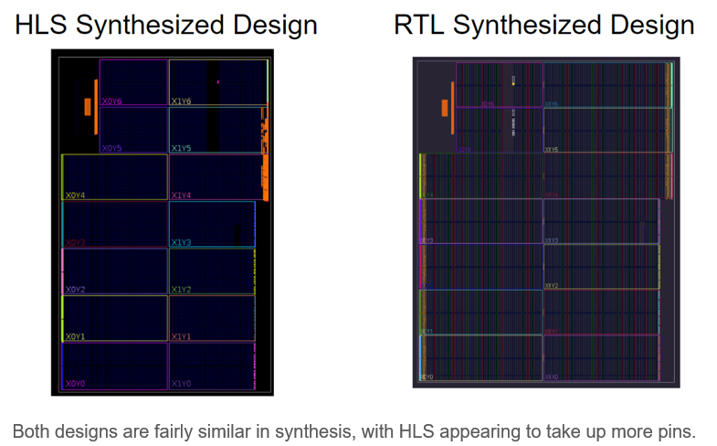
Synthesized Designs

Slide 17
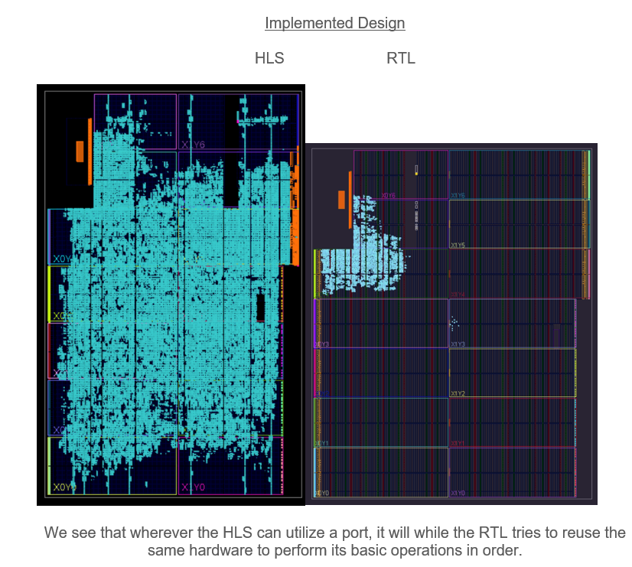
Implemented Designs

Slide 18
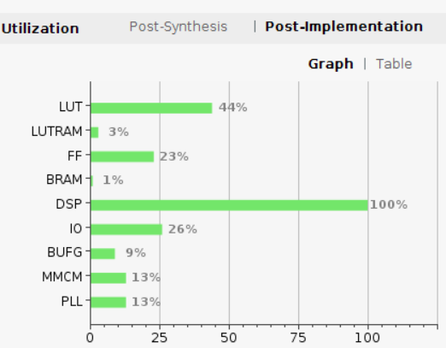
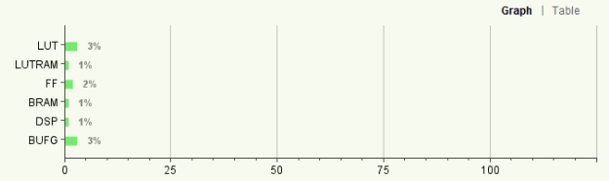
Design Utilization Report
HLS Design Utilization Report
RTL Design Utilization Report

Slide 19
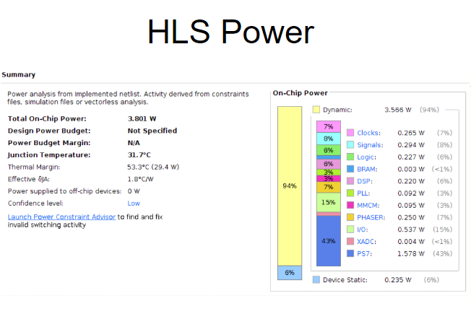
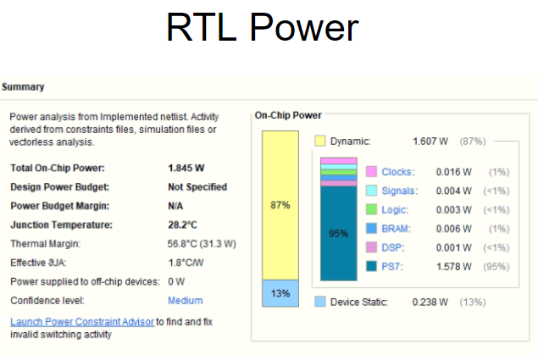
Power Reports

Slide 20
Demo – On-board Inference with Web Camera Integration
A web server hosts a web camera
The PS requests a live image from the web server (current limitation: server is hosted locally)
The web server responds with an image
The image is processed by the PS to match network’s expectations
Localization, Binarization, Reshaping
The processed image is fed to the network on the PL via a DMA send channel
The prediction output of the image is read by the PS via a DMA receive channel
Demo: An image taken through the web camera is processed, and the neural network can successfully classify it!

Slide 21
Future Work
The hard processor (the PS) sends images to and receives output from the neural network (on the PL) through DMA
For DMA to work, we require creating an AXI4 protocol compliant wrapper for our custom Verilog code
This is a really complex task, and we haven’t been able to fully demonstrate this with our RTL code
Long Term Goal: The hard processor will communicate via the FMC connector to a custom daughterboard that will house a 20,000 ReRAM device array for efficient crossbar training & inference

Slide 22
Thank You Questions/Comments?

